Slide 1

A software tool for evaluating clustering algorithms in data mining
Bin Xie

Slide 2
Aim & Objectives
The aim of the project is to create a software tool to help evaluate clustering algorithms.
The objectives for this project include:
Background study for clustering and data mining
To learn different clustering algorithms and their strengths and limitations;
To implement a selection of typical algorithms;
To evaluate the performance each clustering algorithm using synthesized data sets and data sets from public domain.

Slide 3
background
Clustering is widely used in our daily life, examples for the application of clustering includes:
• In marketing
To identify and characterize different customer groups through purchase patterns. Find new potential markets.
• In biology
Group animals and plant’s genes with similar expression levels that shares serval attributes, used to understand the inherent structure.
• Image segmentation
Divide the image into different segments by looking at the grayscale, color, texture, shape and other features

Slide 4

In Insurance industry
identifies the group of car insurance policy holders through a high average consumption
identifies a city's real estate subgroup based on residential type, value, and geographic location
In E-commerce
To group customers with similar browsing behavior
analyze the common characteristics of customers in order to provide more appropriate services.

Slide 5

Why a software tool is needed?
Behind all these applications is about grouping.
Many clustering algorithms has been developed until today
-there is a need to study and evaluate the performance of different clustering algorithms
therefore there is a need for developing a such software tool which allow people to do so.
Visualization can help to understand the patterns better
-improve comprehensibility, can even enable the discovery of new patterns by human eyes.

Slide 6
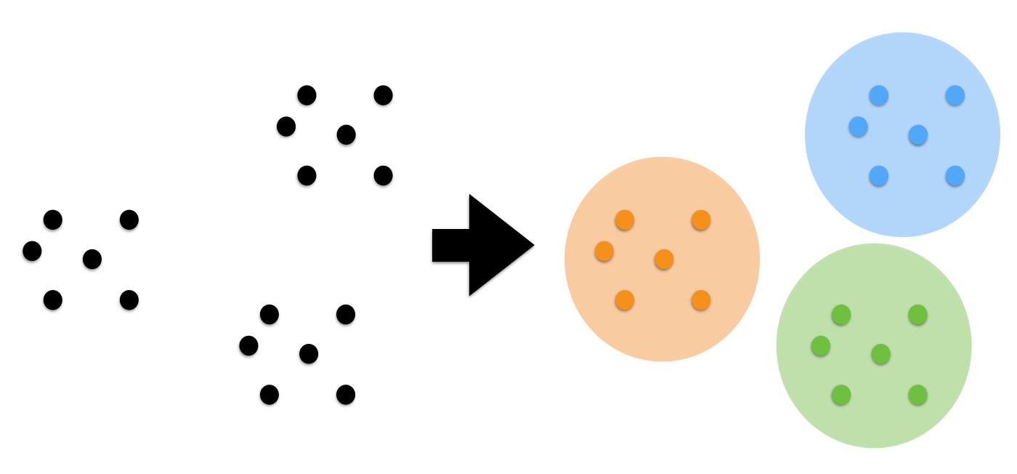
What is clustering:
The term cluster refers to a group of data objects with certain degree of similarity.
A process of discovering clusters from a given set of data objects:
Divide a set of data into groups according to similarity, so
-the data similarity within the group is high
-the data similarity between different groups is low.
no pre-defined classes , unsupervised learning.

Slide 7
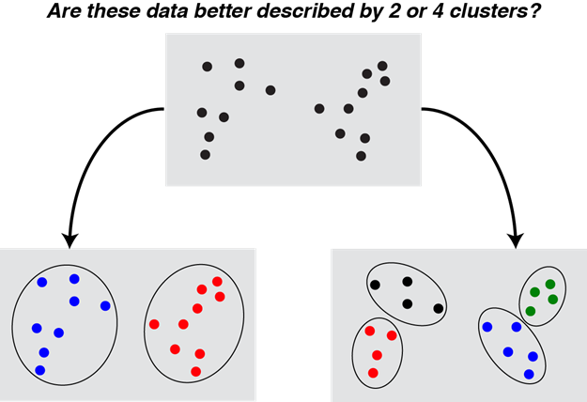
difficulties and challenges
No pre-defined classes =No ground truth
Need to find patterns(potential clusters) from a given dataset with no “right answer”

Slide 8
three essential elements of clustering solution:
A sensible measure of similarity among data objects.
-e.g. Euclidean distance function
A ‘goodness-of-fit’ to evaluate the quality of the resulting clusters
-e.g. SSE
An effective clustering algorithm
- e.g. K-means

Slide 9
Clustering algorithms
Traditional clustering methods can be classified into four categories:
1) Partition methods (e.g. K-means)
2) Density Based methods (e.g. DBSCAN)
3) Hierarchical methods (e.g. Agglomerative hierarchical algorithm/AHA)
4) Model Based methods (e.g. GMM/EM)

Slide 10
Comparing different algorithms
Algorithms | Advantages | Disadvantages
K-means | simple and easy to learn fast and efficient When the data set are dense and spherical, and the difference between clusters is obvious, the algorithm performs very well | Sensitive to the initial defined value Only suitable for spherical shaped data Sensitive to outliers and noise points.
DBSCAN | No need to set k-value Can find clusters of arbitrary shapes Can find outliers not sensitive to noise in the data set. Performs well when data set is dense | Doesn’t perform well when the density of the data set is uneven and the distances between clusters are big，Need to adjust the Eps and MinPts values one set of parameters is used for the entire data set, can’t handle clusters with different densities or nested clusters in the dataset filtering noise points out could lead to incomplete result
Agglomerative | All proximities are measured globally, which leads to globally optimal solution not sensitive to the choice of distance metrics | Computational complexity is too high disadvantage in time complexity requires big memory and computational resources
GMM/EM | flexible, can assume that the data points are Gaussian distributed can take any elliptical shape, rather than being limited to circles. Each data point can have multiple clusters, good for data points located in two overlapping clusters, | Difficult to learn the algorithm Sensitive to initialized value Complex calculations, slow convergence

Slide 11
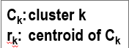
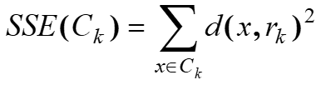
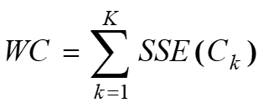
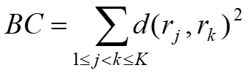
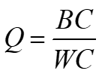
performance evaluation metrics
Good-quality clusters are:
-High-level similarity within a cluster
-High-level dissimilarity between clusters
Measuring metrics
Cohesion: sum of squared errors (SSE), and sum of SSEs for all clusters (WC):
Separation: sum of distances between clusters (BC)
Combining the cohesion and separation, the ratio BC/WC is a good indicator of overall quality.

Slide 12
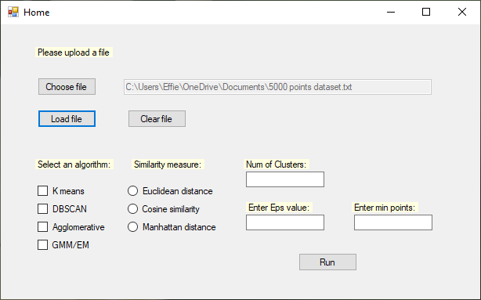

Functions in my software :
Upload data files as input
choose different clustering algorithms & similarity measure functions
Set parameters for different algorithms

Slide 13
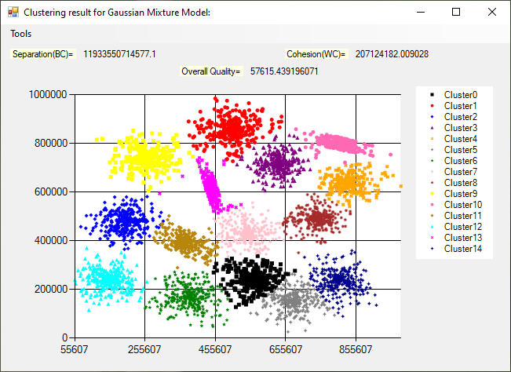
Quality measures for cluster result which has centroids that can be used for calculation
- e.g. K-means, GMM
Display the total number of clusters for each clustering result
Show the cluster results in scatter plot diagram

Slide 14
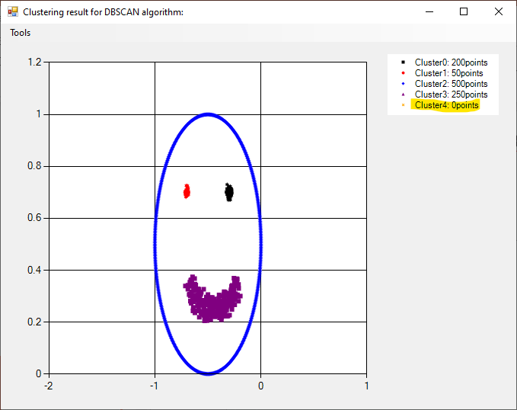
Result displaying for dbscan
Display the number of points in each cluster
Store the noise points in a default cluster

Slide 15
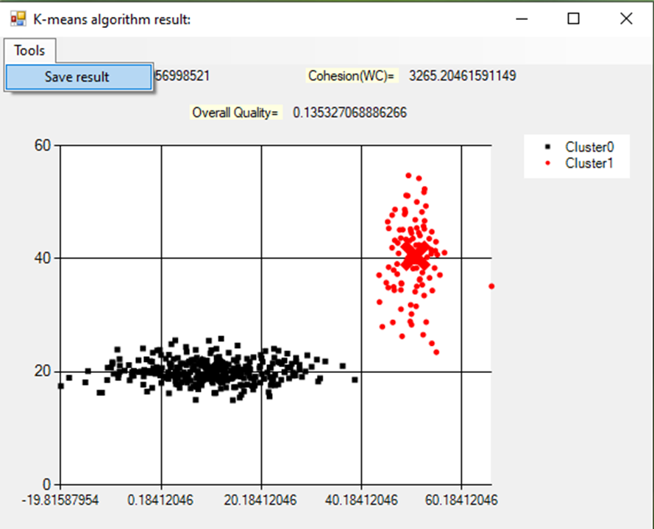
Save the clustering result as text file
Mark the centroids of clusters in K-means clustering result

Slide 16
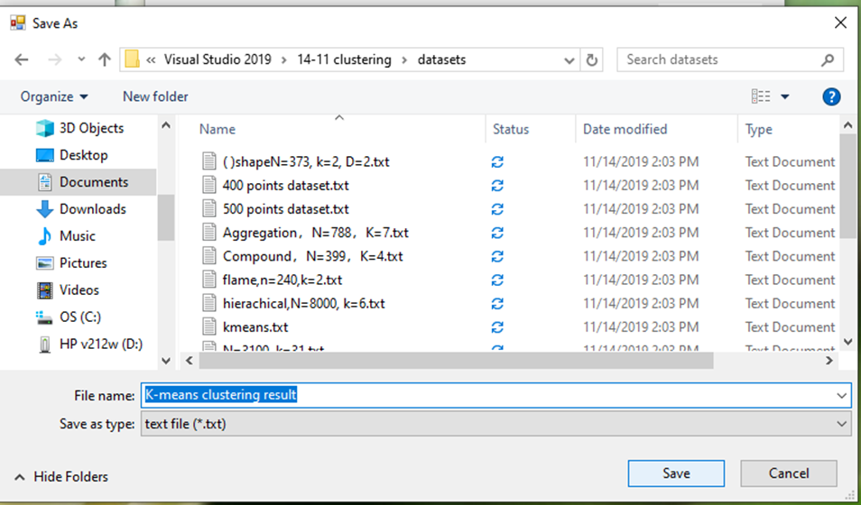
Saving result

Slide 17
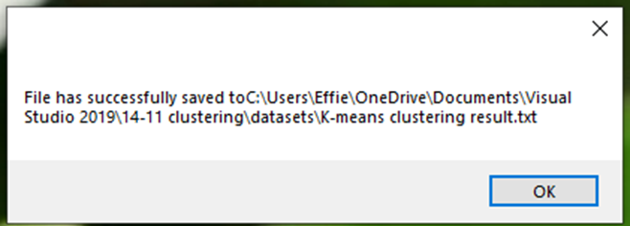
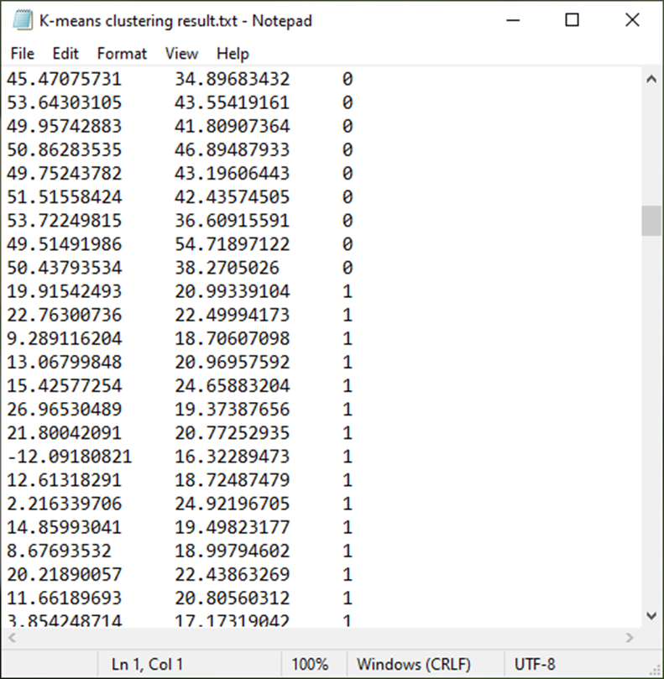
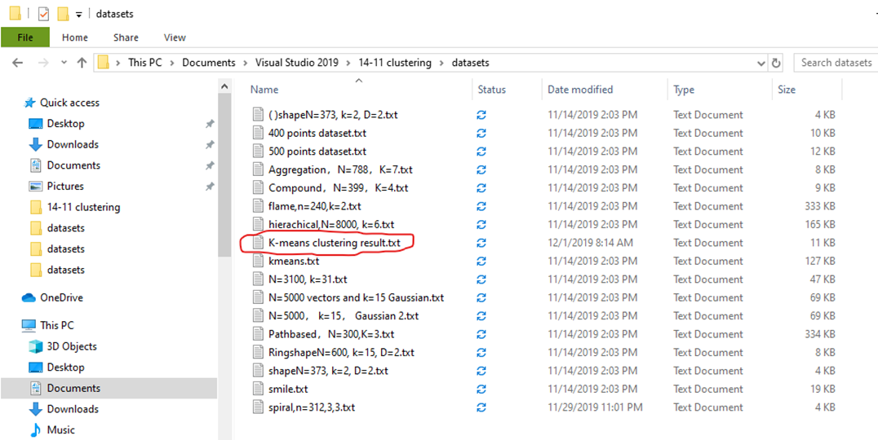

Slide 18
Existing tools
A lot of the commercial tool only implement one clustering algorithm, and they are not designed for evaluating purposes. Below are some existing tools available that can be used for clustering :
KEEL
provides k-Means clustering only.
Mlpy
supports k-Means and Hierarchical Clustering.
PermutMatrix
supports hierarchical clustering only.
Weka
Provides algorithms including K-means, DBSCAN, COBWEB and the EM algorithm, but doesn’t provide the correctness measures.

Slide 19
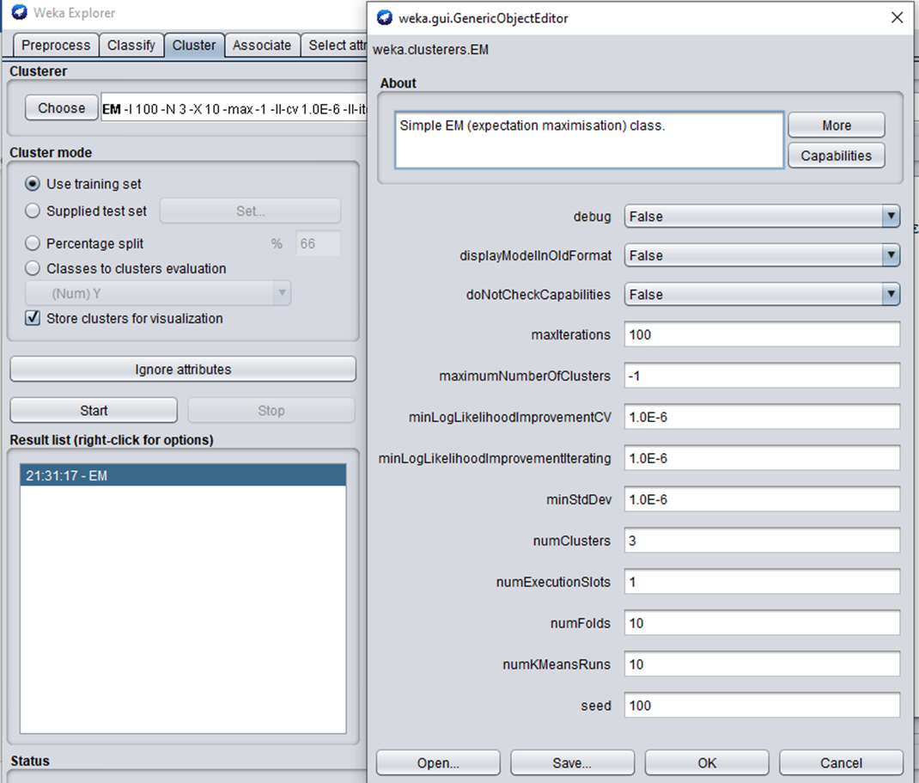
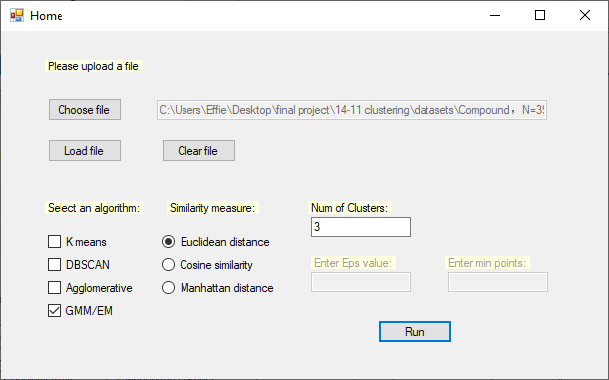
Comparing my software with Weka
GUI of Weka
GUI of my software

Slide 20
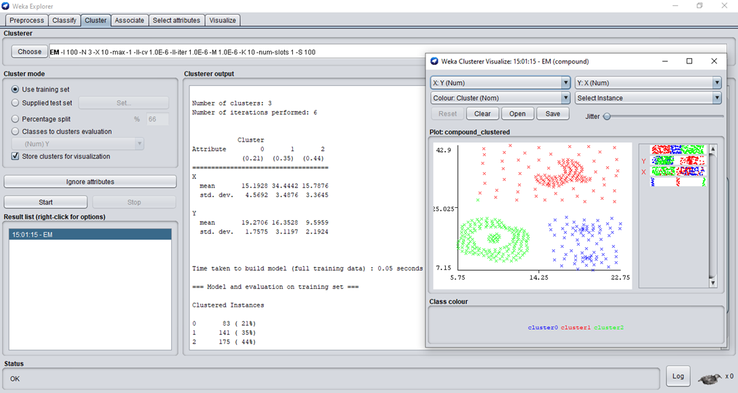
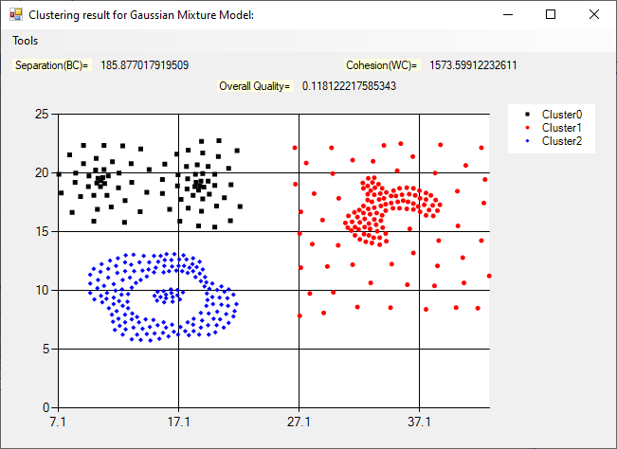
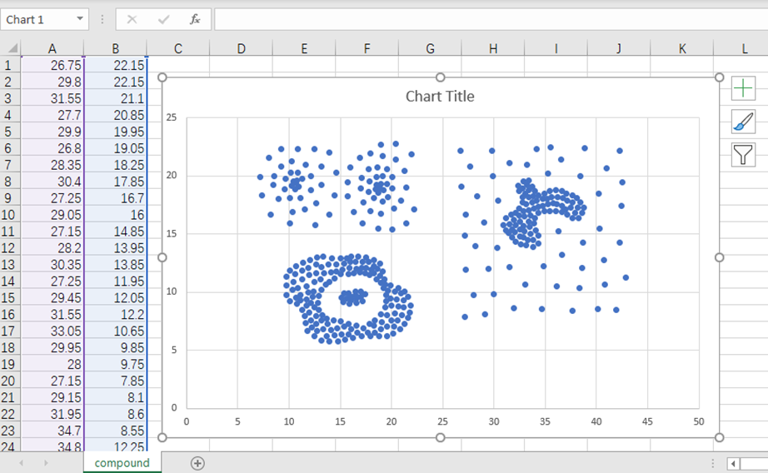
Choosing Same data set as input example, and same algorithm (EM/GMM), number of clusters set to 3:
Clusters result my software plotted matches the original one better
Output from Weka
Original input dataset
Output from my software

Slide 21
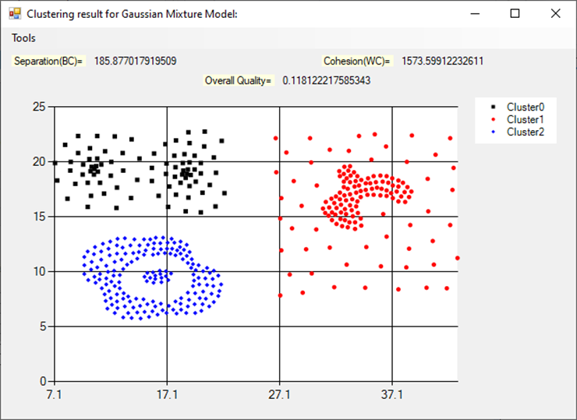
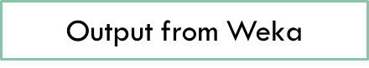

Quality measures are provided

Slide 22
Evaluation of Algorithms
The purpose for evaluating different algorithms is to compare the performance of algorithms in terms of:
Correctness
-whether data are recorded without spurious objects and errors.
Completeness
-whether every data point has assigned to a cluster, whether any value of data object is missing.
Efficiency
-in terms of time taken

Slide 23


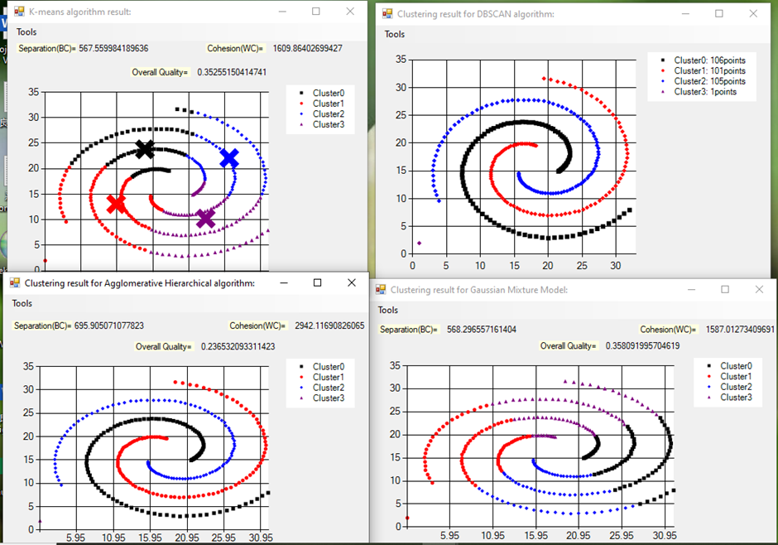
Correctness
Choosing an Arbitrary shaped and dense dataset for comparison
Unlike DBSCAN, K-means algorithm doesn’t works well with arbitrary shaped data.
DBSCAN and the agglomerative algorithm both works well with dense dataset;
GMM/EM doesn’t works well when dataset contains only a small number of data objects for a large number of component distributions
- if there are only a few samples for each component distribution, the estimation is not accurate.

Slide 24
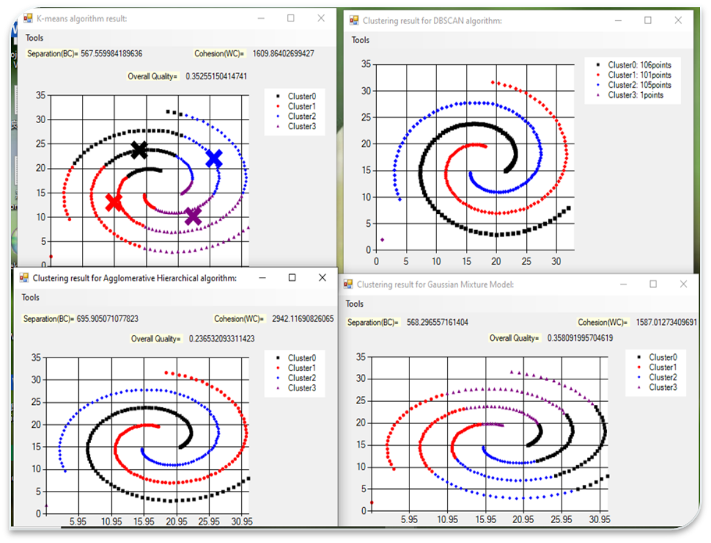
Completeness
There is a noise point in the dataset
-algorithms like K-means always give complete cluster
DBSCAN gives incomplete clusters in general
- it doesn’t care which cluster the noise belongs to.
The noise points are stored in a default cluster for DBSCAN’s result
- I can claim the DBSCAN clustering result from my software is also complete
Overall, all the algorithms I implemented produce complete clusters result.

Slide 25
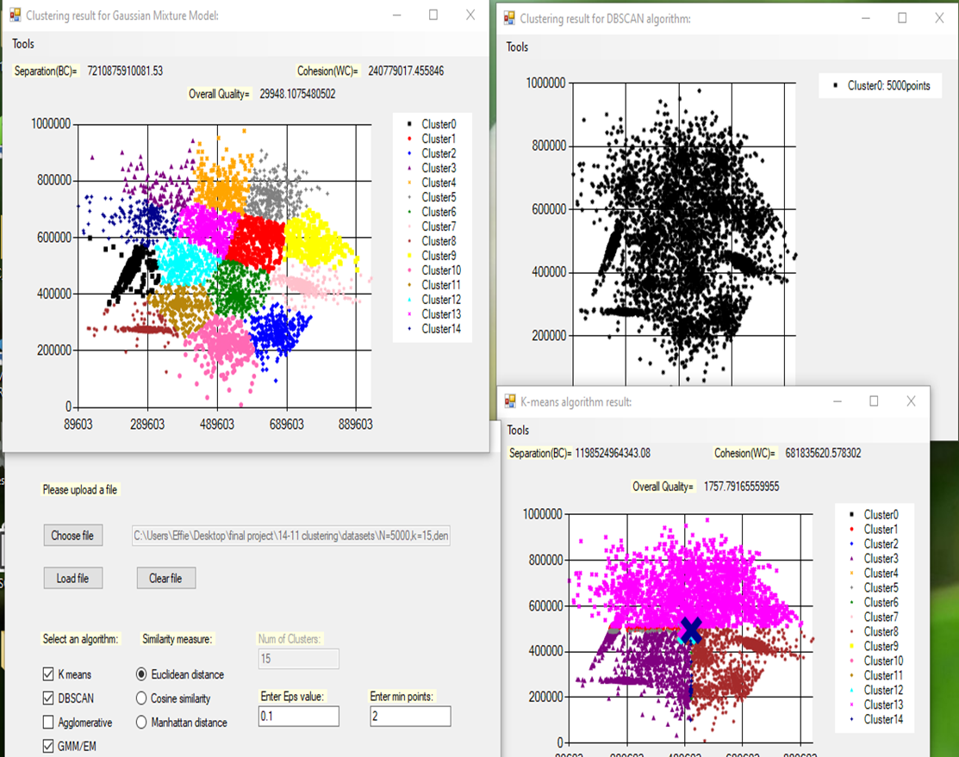
efficiency
the K-means and GMM are faster than DBSCAN and Agglomerative overall
Agglomerative is the slowest
-only two clusters can be merged for each iteration, high time complexity.
The GMM performs well and efficiently with larger and complex dataset
By choosing a Gaussian distributed dataset, 5000 points
-the clustered results from GMM (top-left )are produced in 1 second, with high level of correctness
-while other algorithms like DBSCAN and Agglomerative takes much longer

Slide 26
Conclusion
In practice, not all the requirements can be met by a single clustering solution
-a single clustering solution may not be suitable for different application backgrounds.
A clustering solution can be selected regard to the characteristics of dataset:
- size, shape and density
For algorithms which is sensitive to initial value like K-means
- the algorithm may produce a non-deterministic result if the initial random partition is different.

Slide 27
Strength
The advantages my software has comparing to Weka:
Quality measures are provided
Clusters result are displayed more accurate and neatly with distinct colour codes and marker styles
Easy to use with simple GUI design
Programs written in C# under Visual Studio, no libraries provided
-showed my programming skills and good understanding of algorithms

Slide 28
limitations/Future work
Data is in low dimension (2D)
-could have higher dimension data in future
Agglomerative algorithm
an option allows choosing different linkage method could be done in the future
E.g. average linkage, complete linkage
DBSCAN algorithm
-quality measure could be investigated and provided in the future.
-An idea for quality measure in arbitrary shape cluster:
calculate their average or total sum of distance, if the distances between each other are very small, that means they are tightly close to each other.

